Slide 1
Typography & Data Visualization Design
Created By: Jeffrey A. Shaffer Vice President, Unifund Adjunct Faculty, University of Cincinnati (513) 615-0001 | JeffreyShaffer@gmail.com @HighVizAbility
Notes:
Title Slide

Slide 2
Goals
By completing the course modules, students will:
Understand the fundamentals of typography and graphics
Explore the use of font and its effect on emotion
Learn how typography is used in data visualization.

Slide 3
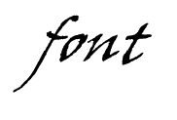
Typography & Data Visualization Design
Who gives a ?
Notes:
Typography and Data Visualization Design: Who gives a font?

Slide 4
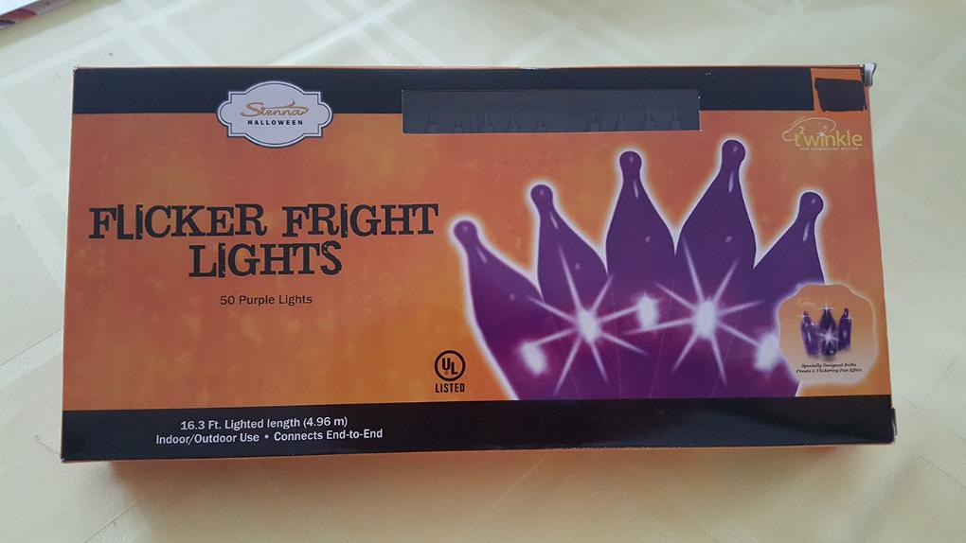
Notes:
The manufacturer spelled flicker with a poor choice of fonts. I don’t think this is what they intended the box to look like. You’ll have to cover the children’s eyes as you walk down this aisle of the store.

Slide 5
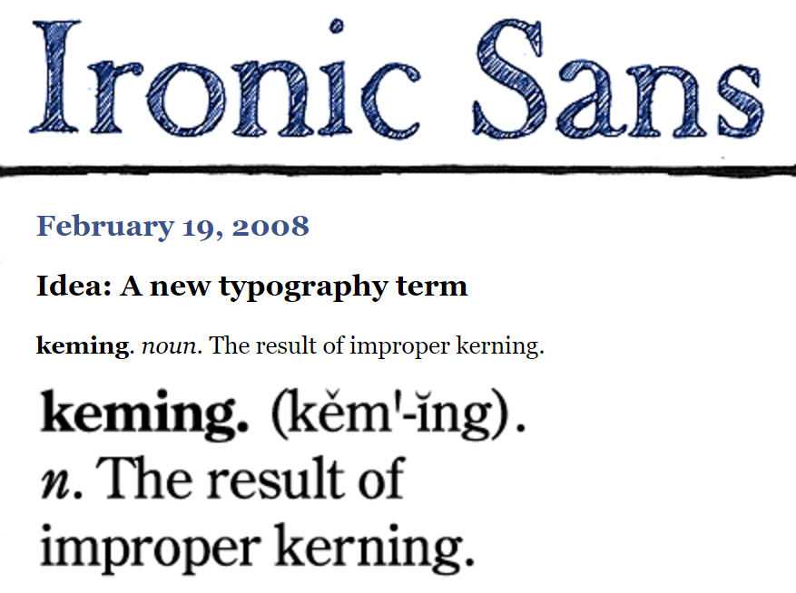
Source: http://ironicsans.com/2008/02/idea_a_new_typography_term.html
Notes:
The website Ironic Sans coined a new term for this exact scenario.

Slide 6
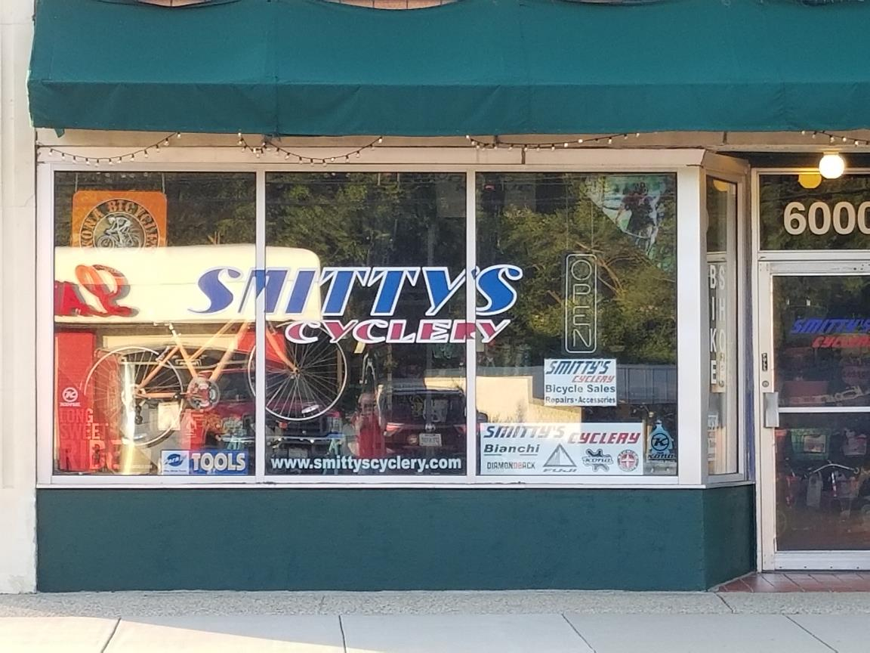
Notes:
And Smitty’s Cyclery could use some better font placement as well.

Slide 7
What is Typography?
Typography - the art and technique of arranging type to make written language legible, readable, and appealing when displayed.
Designing and arranging letters and characters.
The arrangement of type includes:
Adjusting the space between pairs of letters
Selecting
Points sizes
Leading
Line lengths
Letter spacing

Slide 8
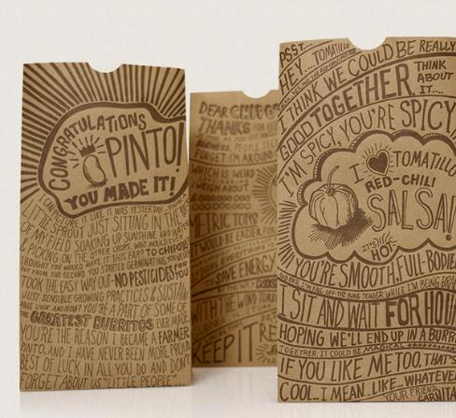
Why is it important?
Typography is everywhere.
Phones
Computers
Billboards
Social Media
Newspapers
Advertisements
Even your Chipotle has aspects of typography that makes it more appealing to the consumer.

Slide 9
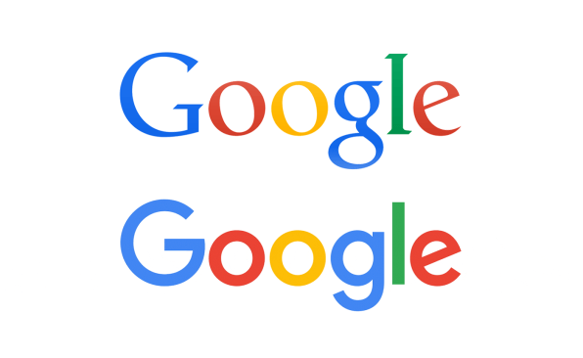
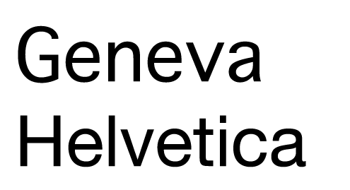
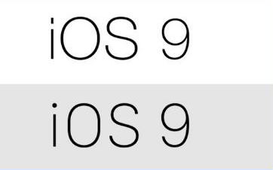
Recent Examples of Typography
September 2015 – Google famously changes its logo to a san-serif type making it easier to scale. This slight change caused a social media uproar.
June 2016 – Facebook changes its typeface from Helvetica to Geneva. The difference was noticeable even though Geneva is only slightly thinner and lighter.
January 2017 – Apple changes its website and iOS 9 operating system from Helvetica Neue to a new typeface they created, called San Francisco, to increase the design appeal.

Slide 10
“If I had never dropped in on that single course in college, the Mac would have never had multiple typefaces or proportionally spaced fonts.”
- Steve Jobs
Notes:
Fun Fact: One of the only college courses Steve Jobs ever took was a calligraphy and typography class. He has credited this class in playing a critical role in the success of Apple.

Slide 11
Typeface vs. Font

Slide 12
Typeface vs. Fonts [A Song vs. an MP3]
These two words are commonly used interchangeably, but they have two very separate meanings.
Typeface is used when describing the what you see. It is an abstract way of describing the way a specific collection of letters or characters looks or feels.
“This typeface really pulls the whole design together” [A Song]
Font describes the physical embodiment or tangible representation of the collection of letters and characters.
“You should change the font size to 14pt so it fits in the box” [an MP3]
Notes:
People tend to use the words typeface and fonts interchangeably, but they mean different things. Nick Sherman used an interesting analogy in a comment on Typographica’s Our Favorite Typefaces of 2007.
Franklin Gothic is a Typeface.

Slide 13
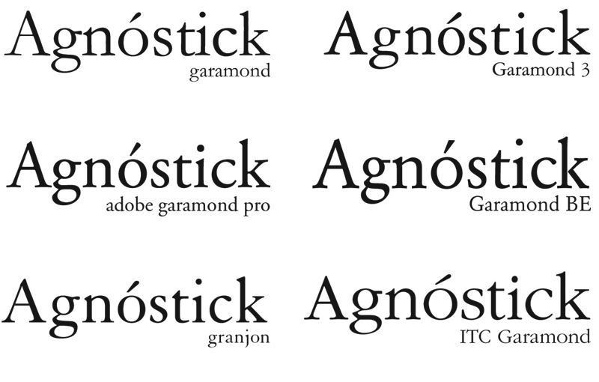
Example using Garamond Typeface
These are all the same typeface – Garamond, but each one of these is a different font.
http://nerdplusart.com/type-terminology-smackdown/

Slide 14
Serif vs. Sans-Serif

Slide 15
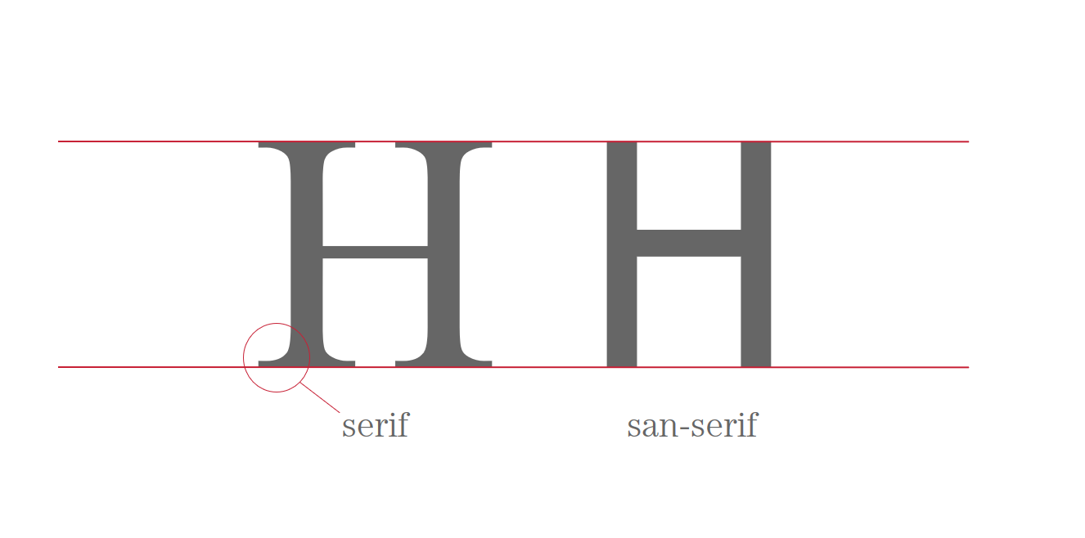
The Anatomy of a Typeface
Notes:
The baseline of the font is the line that the letter sit on. The meanline is the line that fits most of the lowercase letters. This is known as the x-height, which is the height of the lowercase x. The cap height is the distance from the top of the x-height to the top of the uppercase characters. Ascenders can reach above the cap height and descenders go below the baseline.

Slide 16
The Basics of Type Classification
serif
Old Style (Adobe Jenson)
Transitional (Times New Roman)
Modern (Dido)
Slab-serif (American Typewriter)
sans-serif
Grotesque (News Gothic)
Neo-Grotesque (Helvetica)
Humanist (Gill Sans)
Geometric (Futura)

Slide 17
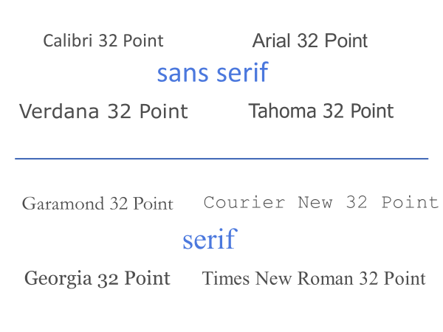
Notes:
Fonts can be split into serif and san serif fonts. Serifs are little feet or hooks on the font. The word “sans” means “without”. So sans serif means without feet. Notice that a “32 point font” does not mean they are all the same size. The size of Calibri at 32 point font is much smaller than Verdana at 32 point.

Slide 18
Anatomy of a Typeface
Notes:
Works Cited – All of the definitions and photos for the definitions used in this section were used from https://blog.hubspot.com/marketing/typography-terms-introduction.

Slide 19
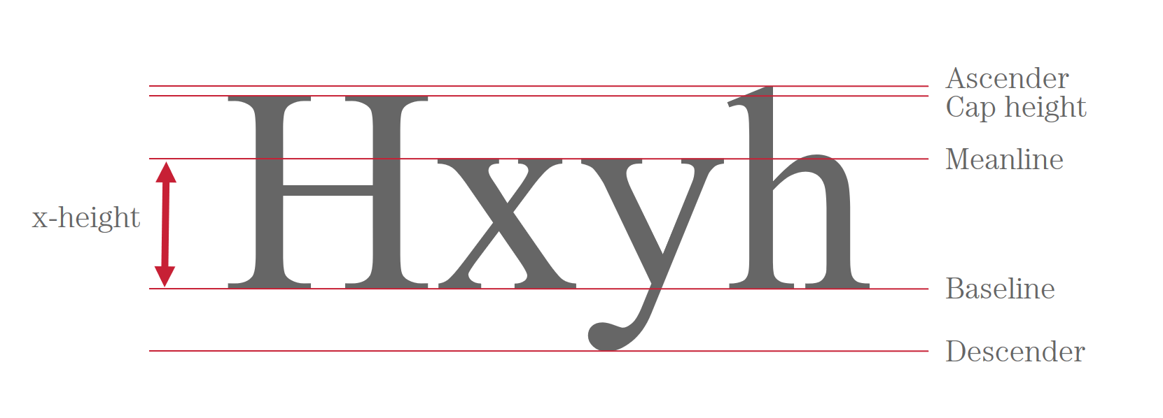
The Anatomy of a Typeface
Adapted from A Crash Course in Typography: The Basics of Type
Source: https://www.noupe.com/essentials/icons-fonts/a-crash-course-in-typography-the-basics-of-type.html
Notes:
Cap height: The distance from the baseline to the top of the capital letter.
Meanline: the line that fits most of the lowercase letters. This is known as the x-height, which is the height of the lowercase x.
X-height: Is the distance between the baseline and the meanline, it's the height of the body of the lowercase letter, for example, the lowercase letter x (hence the name).
Baseline: The line where the letters sit.
Ascender: The portion of a letter that extends above the meanline of a font -- i.e., is taller than the font's x-height. (In this case, you’ll also notice the letter ‘h’ is actually taller than the x-height.)
Descender: The longest point on a letter that falls beyond the baseline.

Slide 20
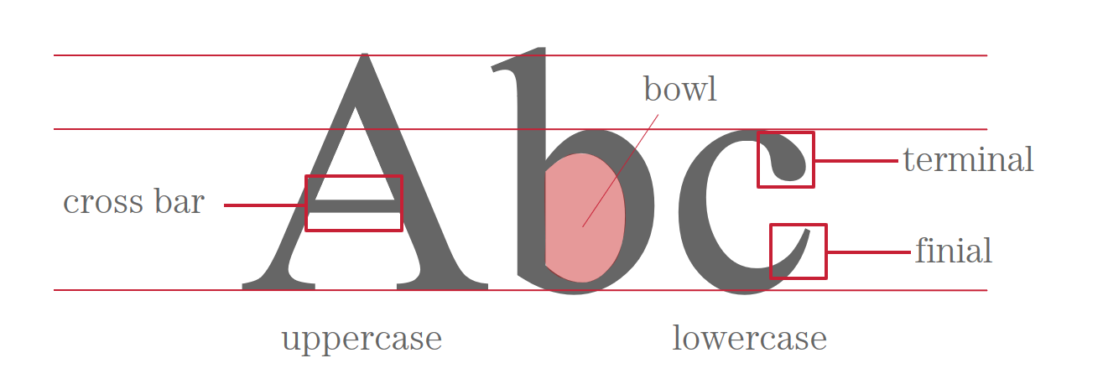
The Anatomy of a Typeface
Notes:
Cross bar: The bar that goes across the inside of the letter and connects one side to another. (In this case, it's the bar inside the capital letter 'B.')
Bowl: The curved part of the character that encloses the circular or curved parts of some letters, like 'd,' 'b,' 'o,' 'D,' and 'B.' (In this case, it's that round shape of the letter ‘b')
Finial: The tapered end of letters such as ‘e’ or ‘c.'
Terminal: A type of curve that you see at the top of the letter ‘f’ or the end of the letter ‘j.'

Slide 21
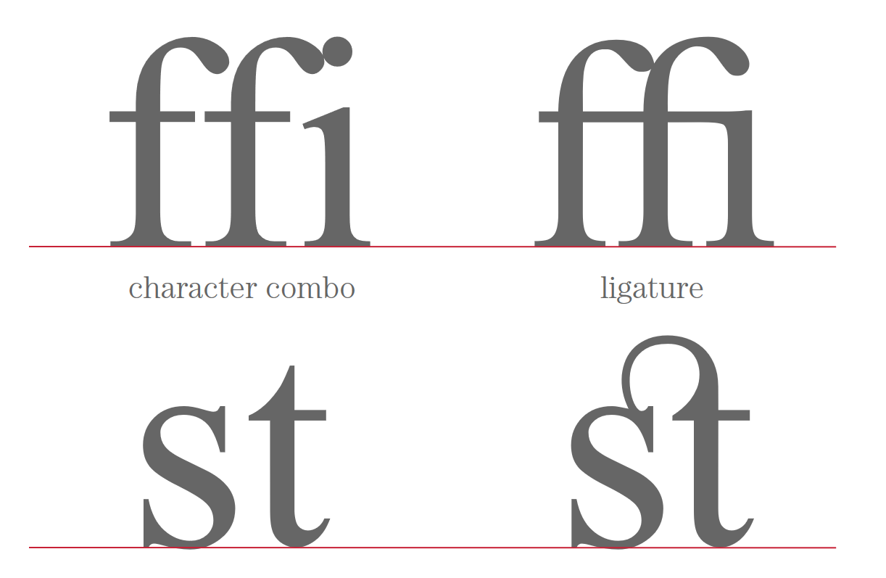
The Anatomy of a Typeface
Notes:
ligature: two or more letter are joined as a single glyph. This is see too often in web or even print, but it can create beautiful look and in some cases increase readability.

Slide 22
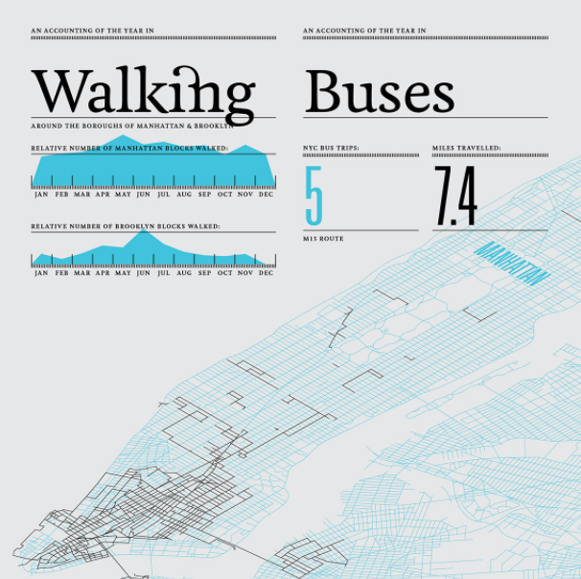
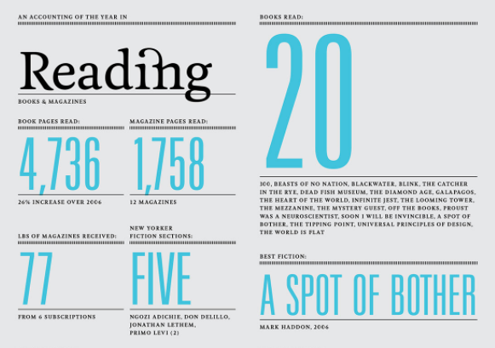
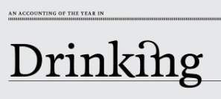
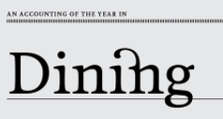
2007 Feltron Report
http://feltron.com
Notes:
Notice the beautiful ligature connecting the i and n used here by Nicolas Felton in his 2007 Feltron Report.

Slide 23
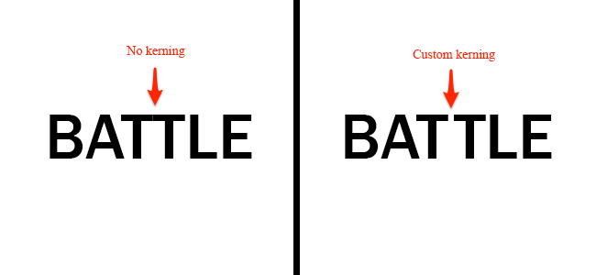
The Anatomy of a Typeface
Source: https://blog.hubspot.com/marketing/typography-terms-introduction
Notes:
Kerning is the modification of the space between two letters.

Slide 24
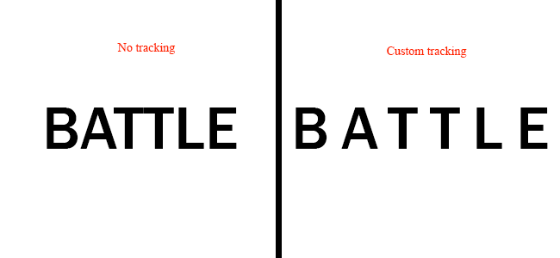
The Anatomy of a Typeface
Source: https://blog.hubspot.com/marketing/typography-terms-introduction
Notes:
Tracking is very similar to Kerning however tracking adjusts the space between all letters to distribute them evenly rather than altering two letters.

Slide 25
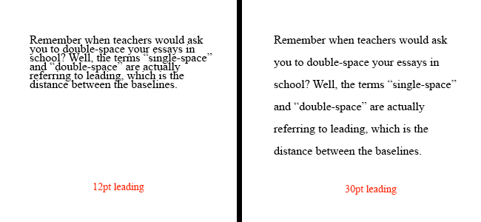
The Anatomy of a Typeface
Source: https://blog.hubspot.com/marketing/typography-terms-introduction
Notes:
Leading is defined as the distance between baselines. You can increase or decrease your leading which pushes or pulls your lines of text respectively. Increasing the leading can make it much easier to read more lines of text.

Slide 26
Does Typography Connote Emotion?

Slide 27
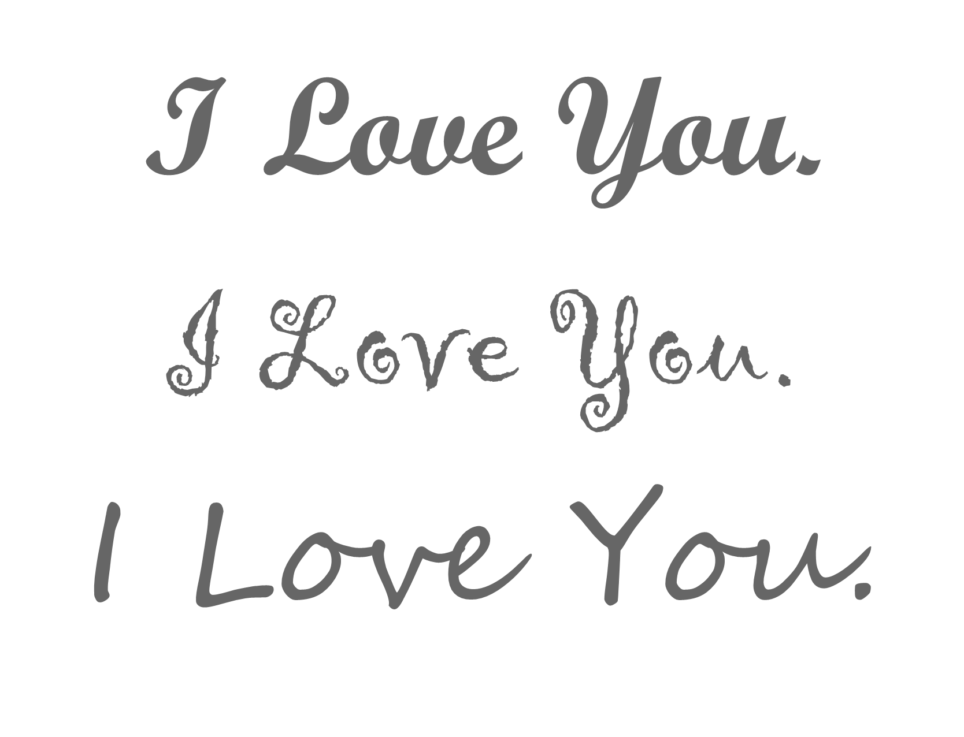
Notes:
Consider the emotions that are tied with the way words are expressed on the page. What does this text make you think of?
[Love note, handwritten message?]

Slide 28
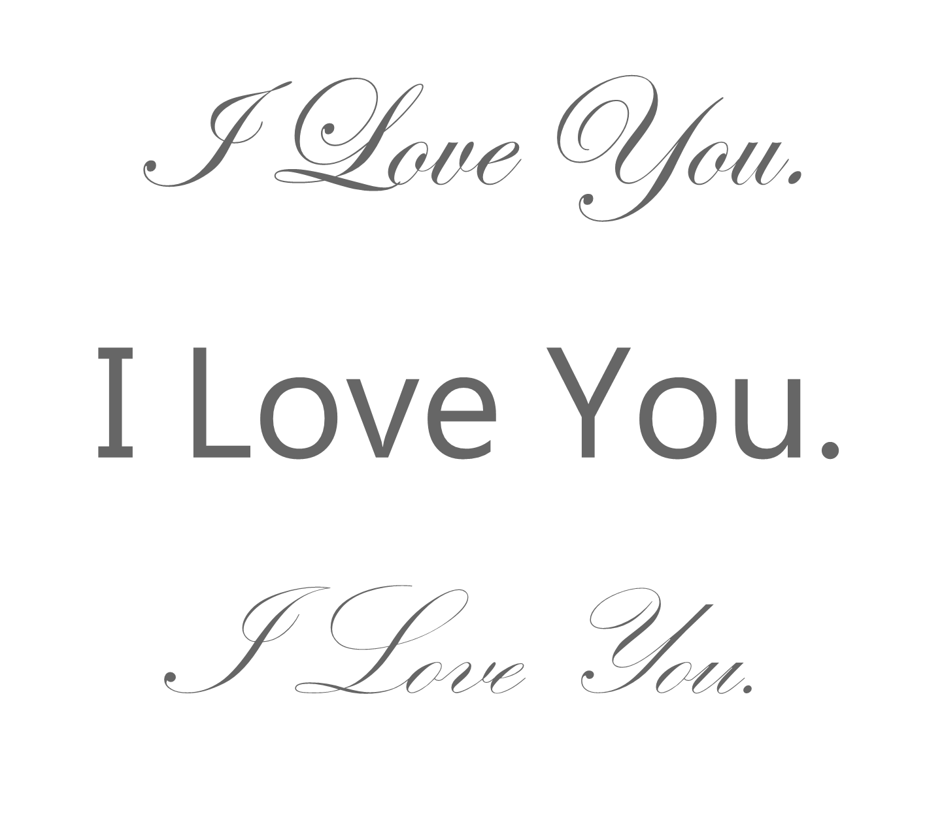
Notes:
How about this one?
[A wedding invitation? Or a greeting card for Valentine’s Day?]

Slide 29
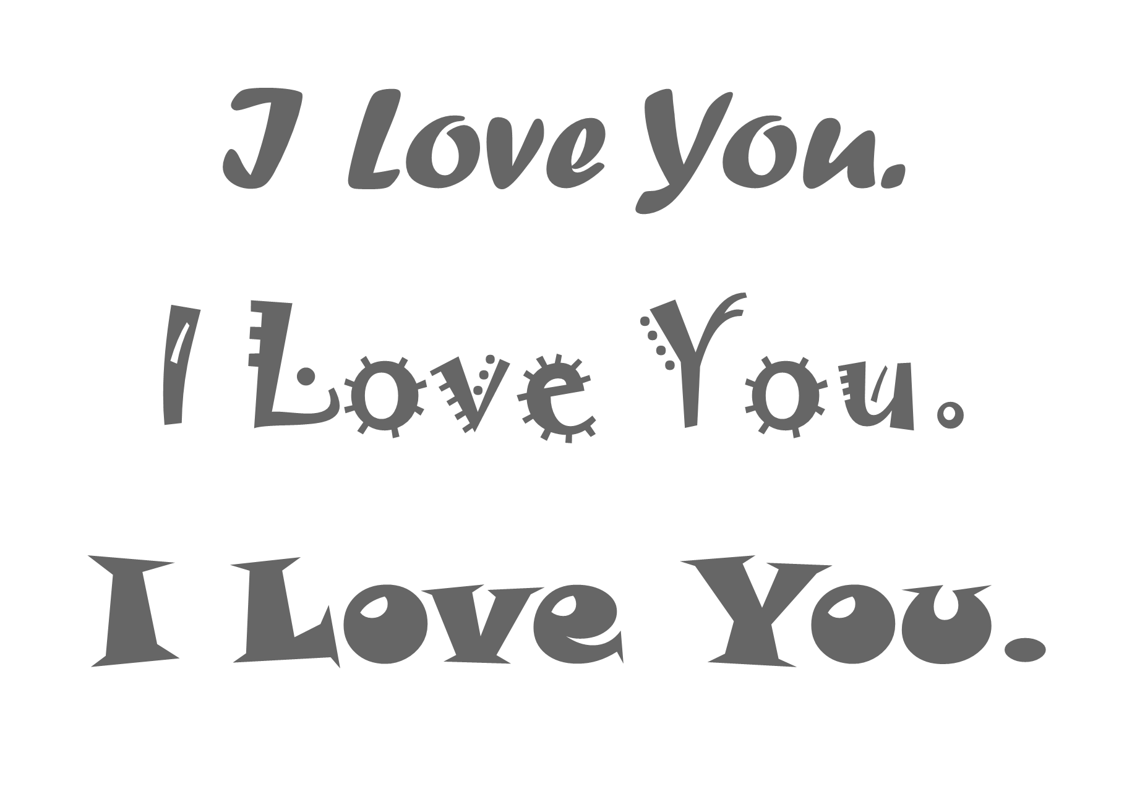
Notes:
And this one?
[Kids]

Slide 30
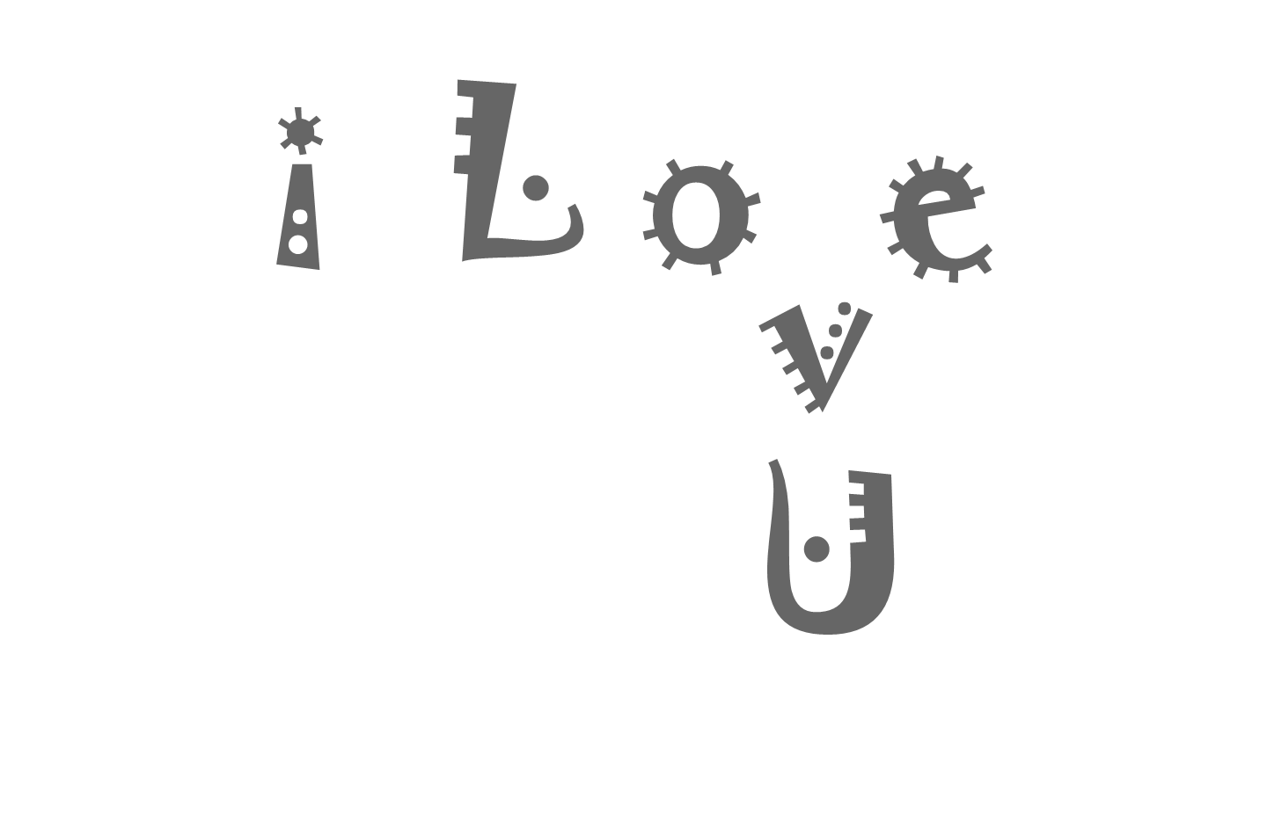
Notes:
Something that kids would have a really fun time with. Making a smiley face out of it for a card.

Slide 31
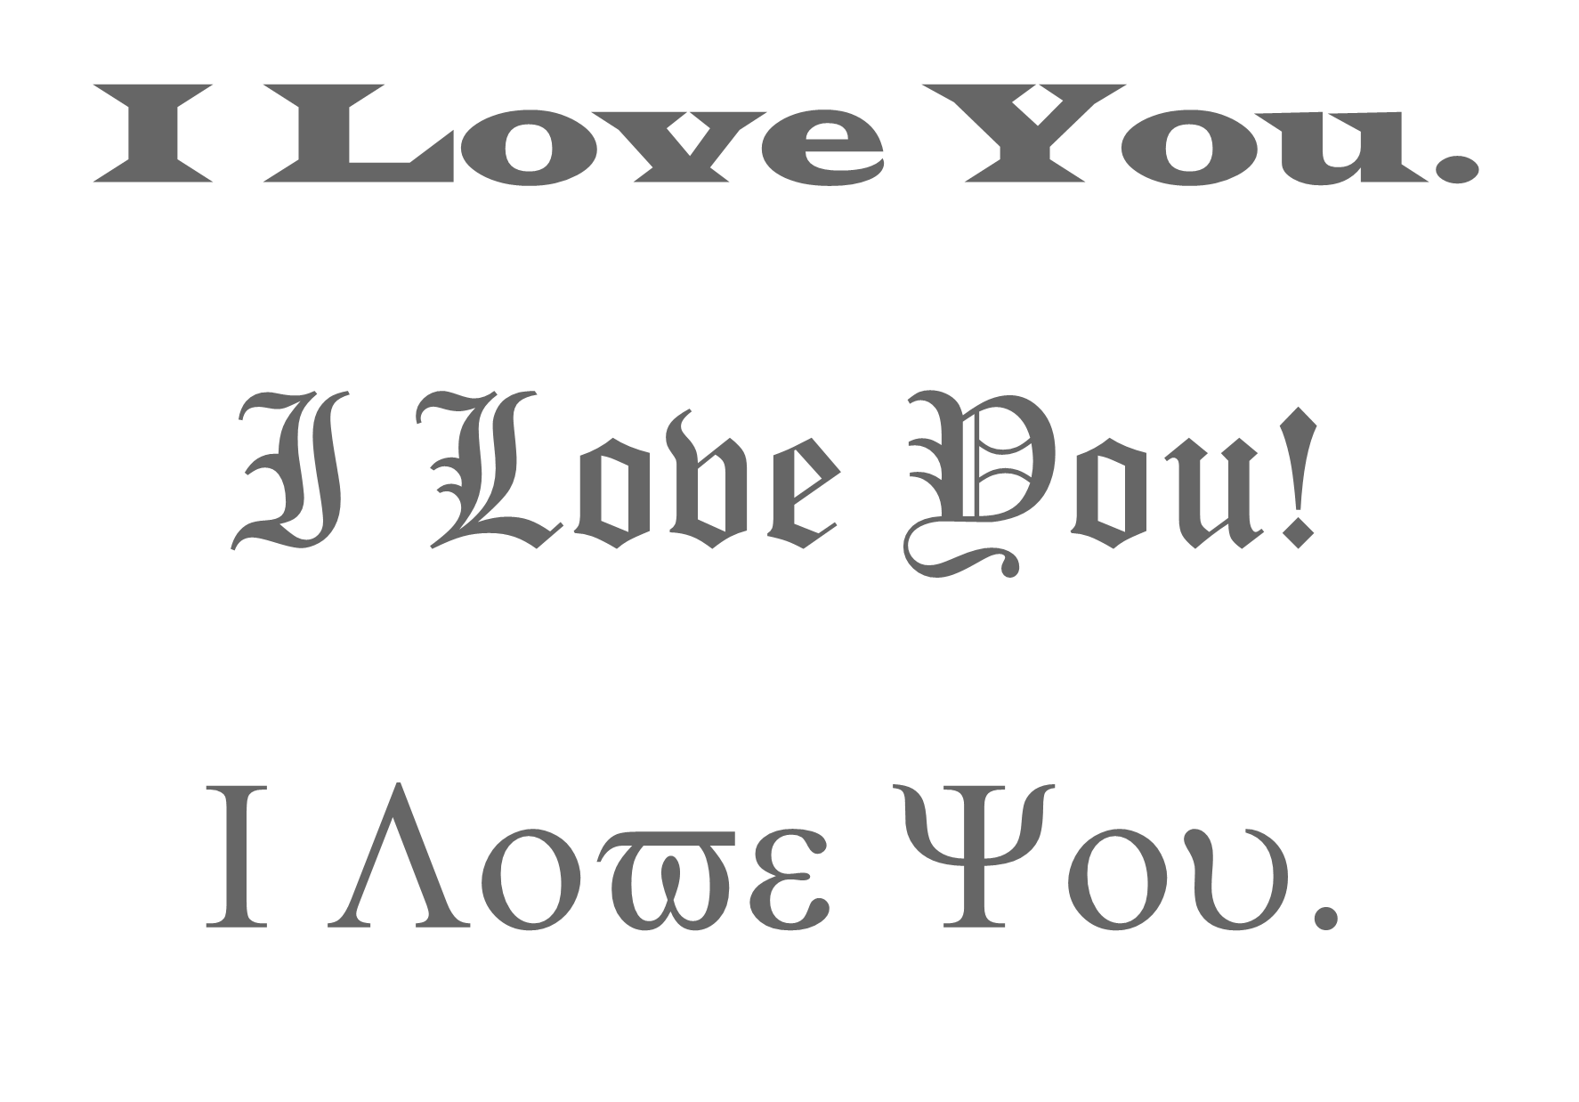
Notes:
What about this? Would you date this person? I LOVE YOU!

Slide 32
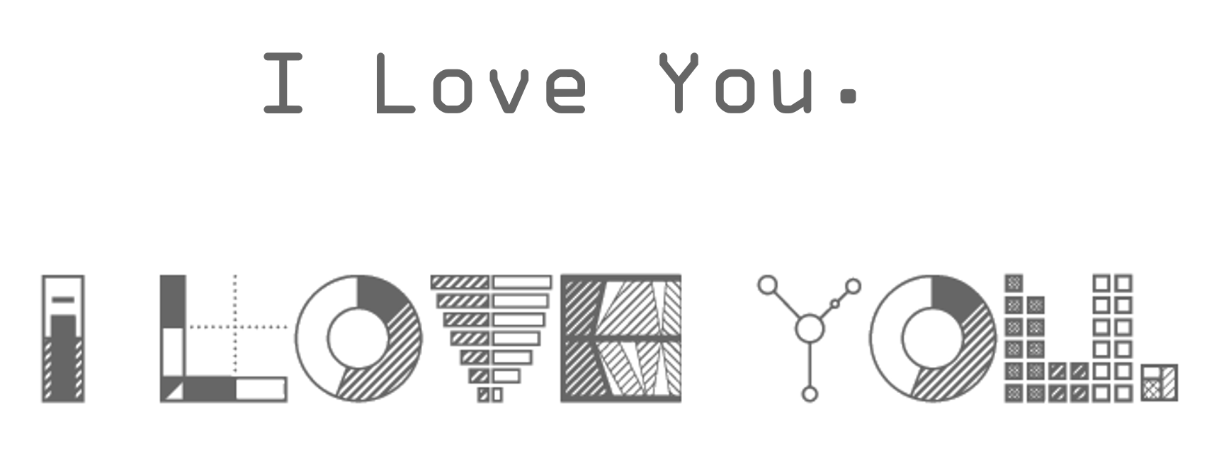
Notes:
And this person really loves data viz, charting their love into a typeface.

Slide 33
Perception of Fonts
Perceived Personality Traits and Uses

Slide 34
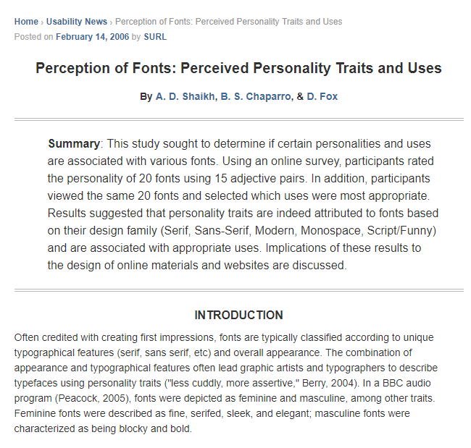
A Research Study in 2006
Emotions and Personalities
associated with different fonts.
serif fonts – “stable”, “practical” and “mature”
sans serif – not positive or negative
script – ‘”feminine”
Modern fonts – “assertive” and “coarse”
Notes:
A research study from 2006 studied the perception of fonts. Specifically, if there were personalities and uses associated with various fonts. Serif fonts were thought to be stable and practical, while script fonts were perceived as feminine. Modern fonts were coarse and assertive and sans serif fonts were very neutral, neither positive or negative.

Slide 35
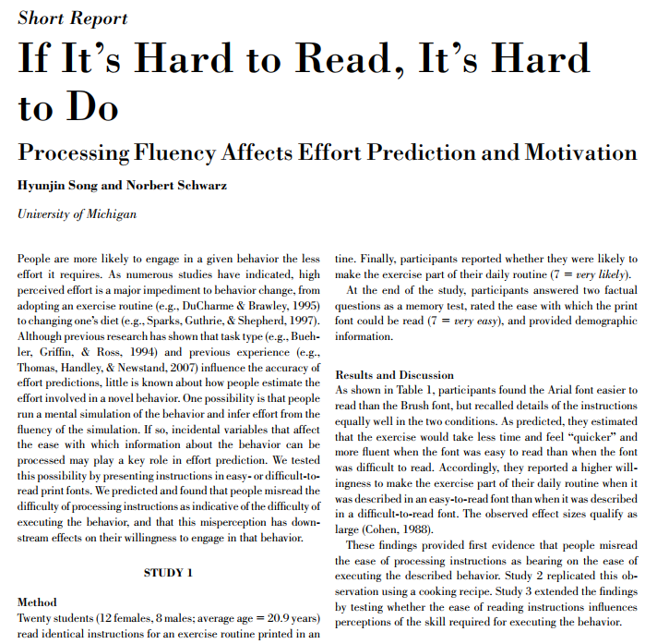
A Research Study in 2008
“the challenging font choice made the task seem to require more time to achieve.”
Notes:
A 2008 study found that the more challenging a font was to read, the more challenging the task was perceived. The same task was asked of participants, but in very different fonts. The participants felt that the task was more difficult to complete when the font was hard to read, even thought the task was no different.

Slide 36
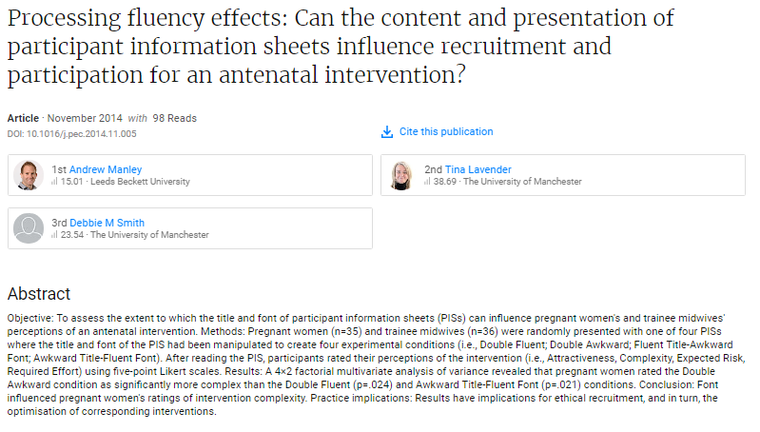
A Research Study in 2014
Processing fluency effects: Can the content and presentation of participant information sheets influence recruitment and participation for an antenatal intervention?
The easier the font was to read, the less complex the intervention was perceived
Notes:
A 2014 study showed that the easier a font was to read, the less complex the intervention was perceived.

Slide 37
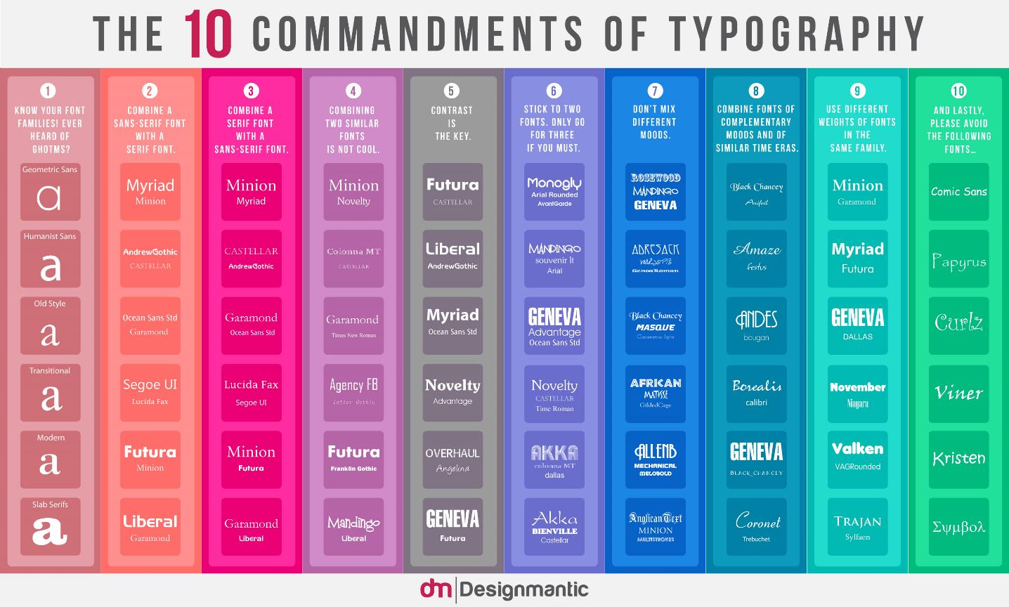
Notes:
Available in high resolution form Designmantic.
https://www.designmantic.com/blog/wp-content/uploads/2014/04/font-infography.jpg

Slide 38
10 Rules for Effectively Combining Fonts
Source: https://designschool.canva.com/blog/combining-fonts-10-must-know-tips-from-a-designer
Notes:
Source:
Photos for the definitions used in this section were used from https://designschool.canva.com/blog/combining-fonts-10-must-know-tips-from-a-designer

Slide 39
10 Rules for Effectively Combining Fonts
Choose complimentary fonts
Establish a visual hierarchy
Consider context
Mix serif with sans serif
Create contrast
Stay away from font conflict
Avoid fonts that are too similar
Use fonts in the same family
Limit the number of fonts used
Practice
Source: https://designschool.canva.com/blog/combining-fonts-10-must-know-tips-from-a-designer

Slide 40
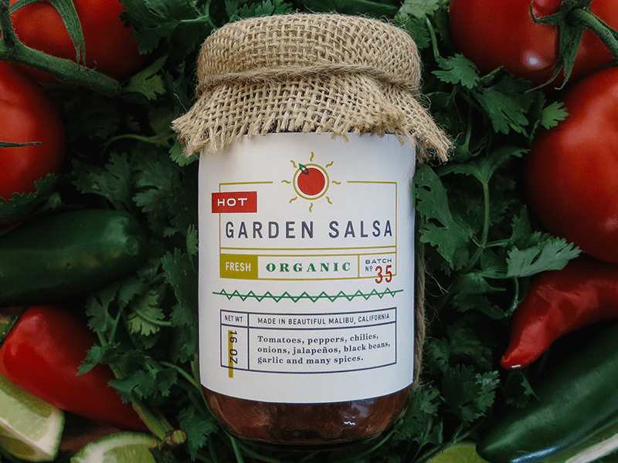
Choose complimentary fonts
Notes:
Fonts have different aesthetics to them that create different moods and have different personalities. For example you may use bubble letters for a birthday party invitation but it wouldn’t be appropriate for a business memo. Getting the hang of this takes trial and error to develop an idea of what works.

Slide 41
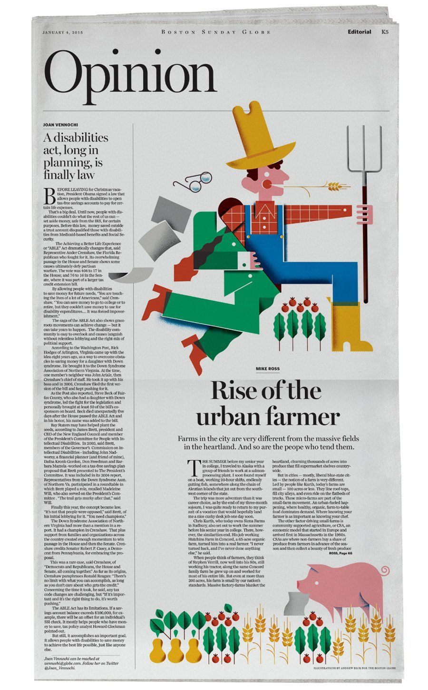
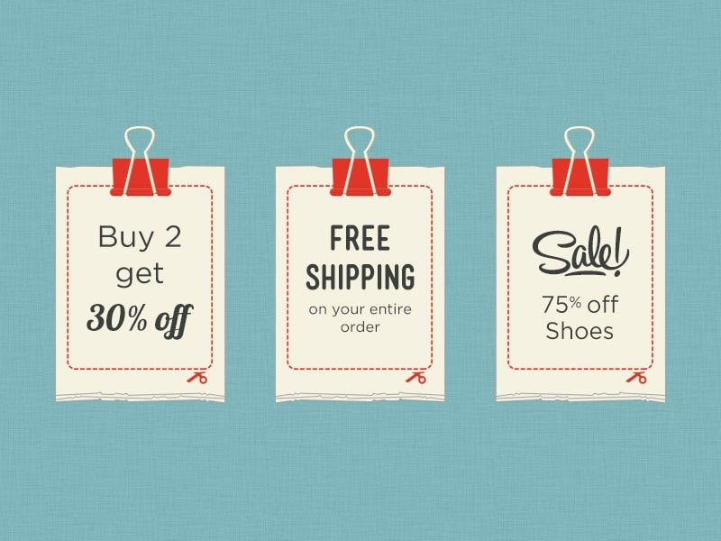
2. Establish a visual hierarchy
Notes:
Use bold, italics, headlines and subhead lines, and captions to organize how the letters and characters are read on the page. A good way to organize font based on hierarchy is to determine which information is the most important and make that stand out.

Slide 42
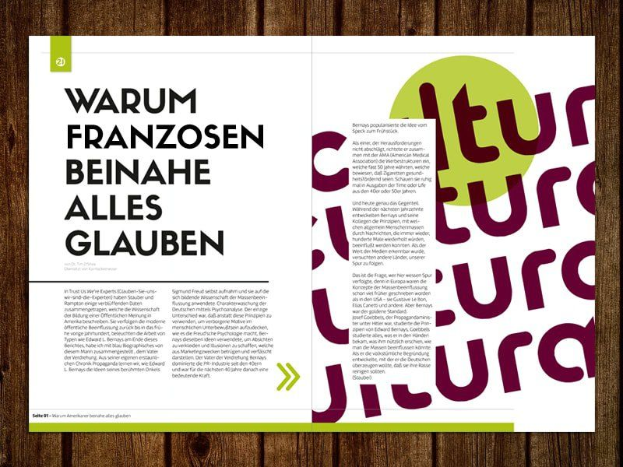
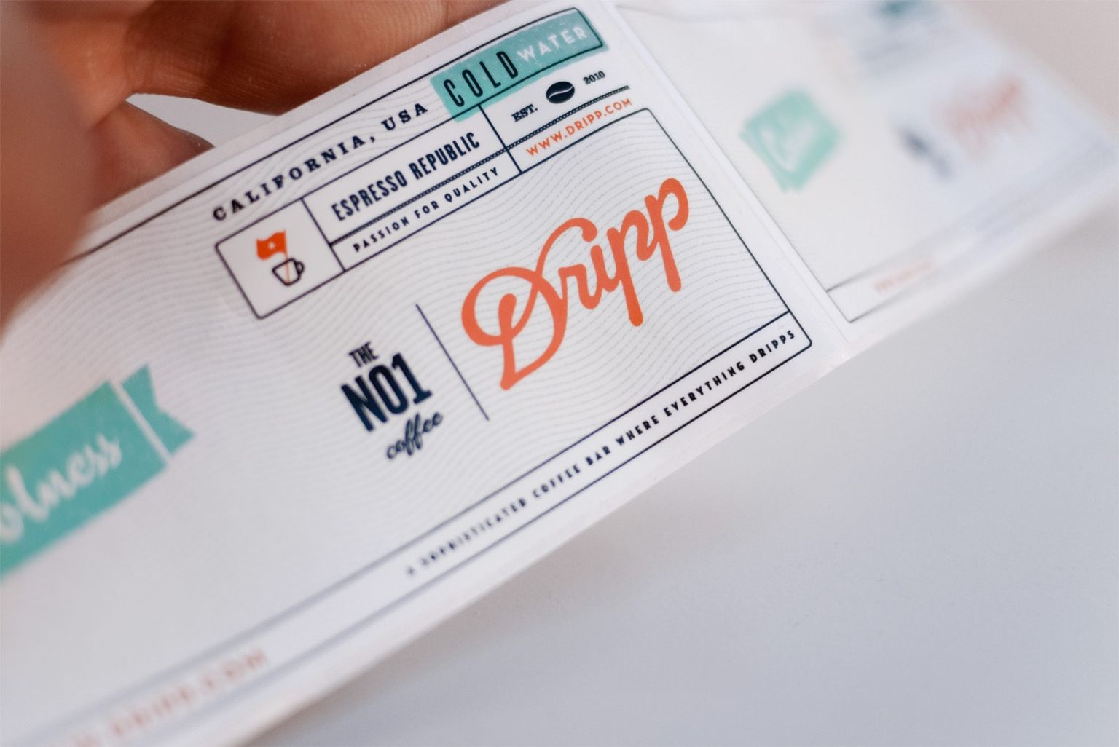
Consider context
Notes:
Keep in mind where your font will be places. Use fonts that will be easy to read in the space provided as well as use font size to help with readability. Another aspect of context and realizing when to use a neutral font vs. something that grabs your attention.

Slide 43

Mix serif with sans serif
Notes:
As long as you stay within the same type family serif and sans serif tend to look good together,

Slide 44

Create contrast
Notes:
You can achieve contrast in a number of ways such as size, color, serif vs. sans serif, space etc. Differences in font can help make separate roles for the font letting them show different information.

Slide 45
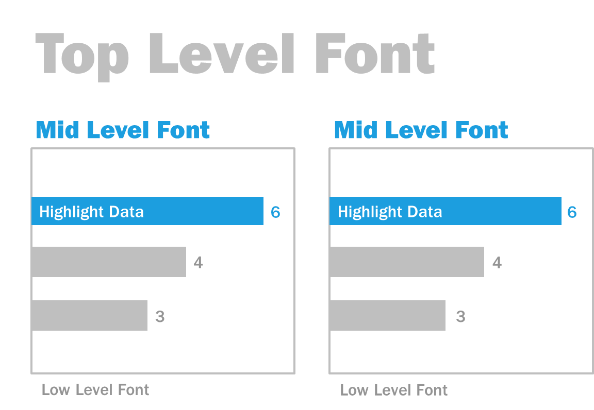
Notes:
Here is the hierarchy used in the Complaints Dashboard from The Big Book of Dashboards. Notice the very large font size, and the choice of font, for the top level font. The mid level font is in blue, which on the Complaints Dashboard is also used to highlight the two most recent rating periods. If the top level font were blue it would completely dominate the visualization. Having the top level in the lighter gray and the mid level in blue creates a balance of the font levels.

Slide 46
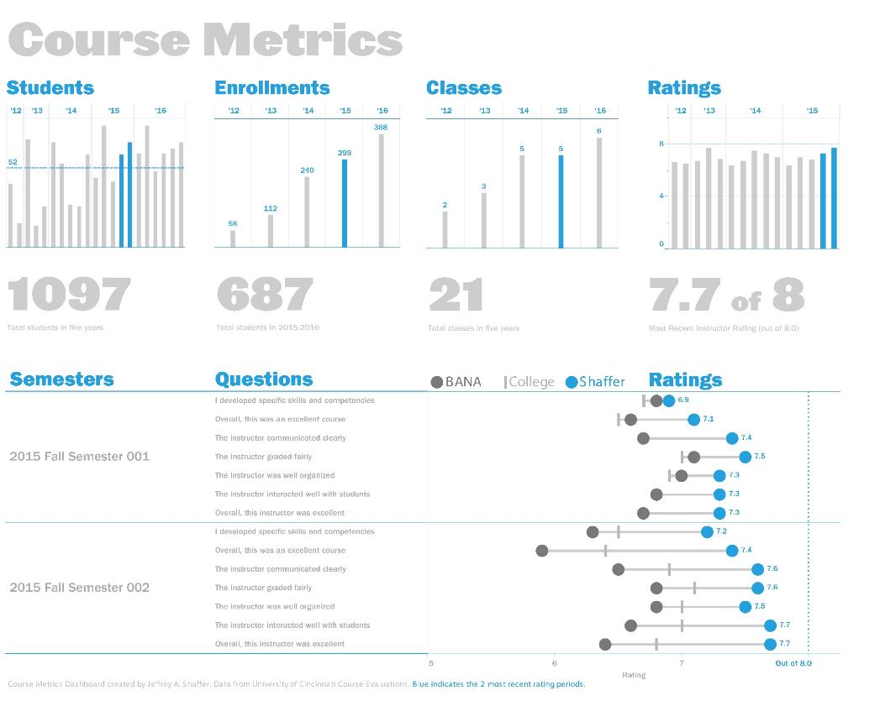
Source: The Big Book of Dashboards (BigBookofDashboards.com)

Slide 47
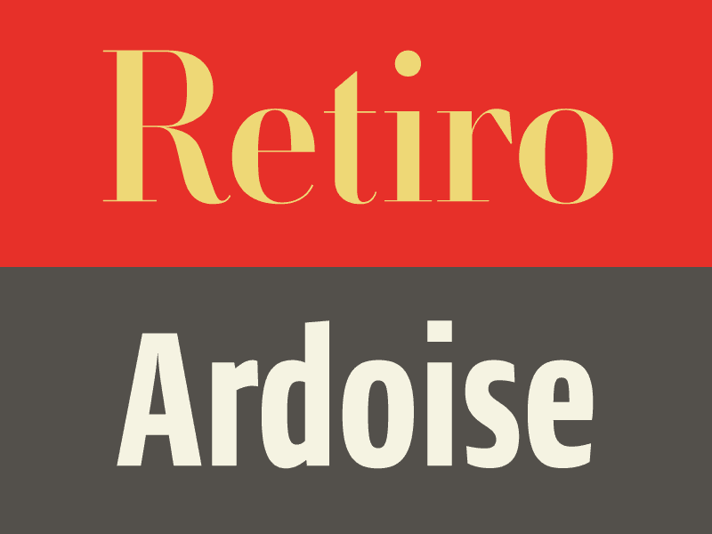
Stay away from font conflict
Notes:
While contrast can be helpful in font design avoid fonts that are drastically different.

Slide 48
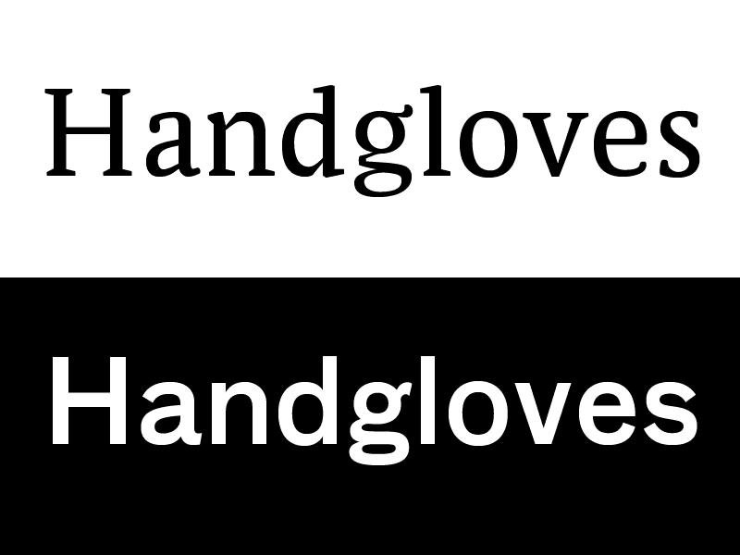
Avoid fonts that are too similar
Notes:
On the flipside you also want to avoid fonts that are too similar because you will be unable to establish the hierarchy and be unable to display those distinct roles of each font.

Slide 49
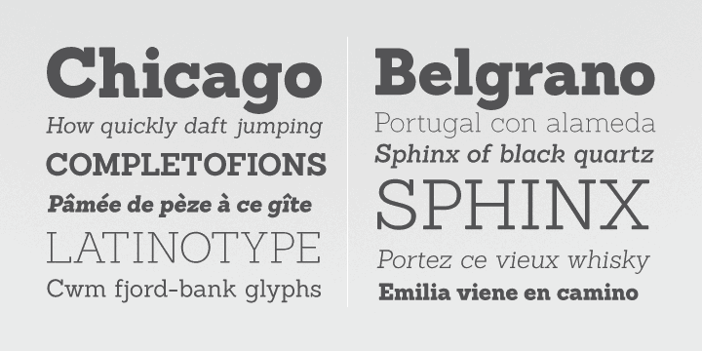
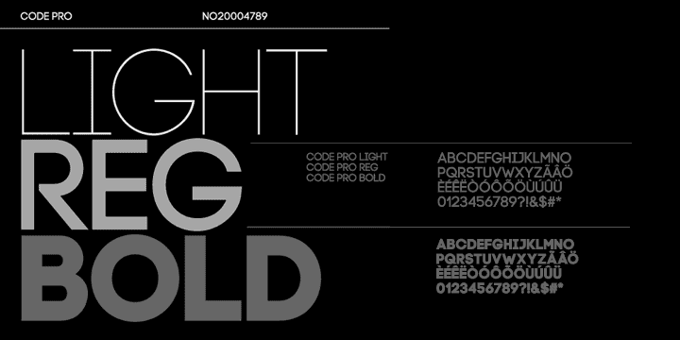
Use fonts in the same family
Notes:
Fonts in the same family are usually made to work together well, so it is a good idea to merge different fonts from the same family to create the variation needed for a good design.

Slide 50
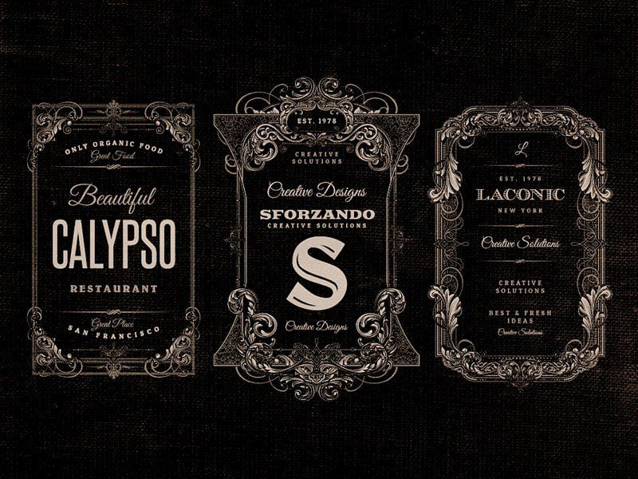
Limit the number of fonts
Notes:
The rule of thumb is to usually stick to two or three fonts. A large variety of fonts can look good when going for certain aesthetics but there is a thin line before the amount of fonts looks conflicting and cluttered.

Slide 51
10. Practice Makes Perfect

Slide 52
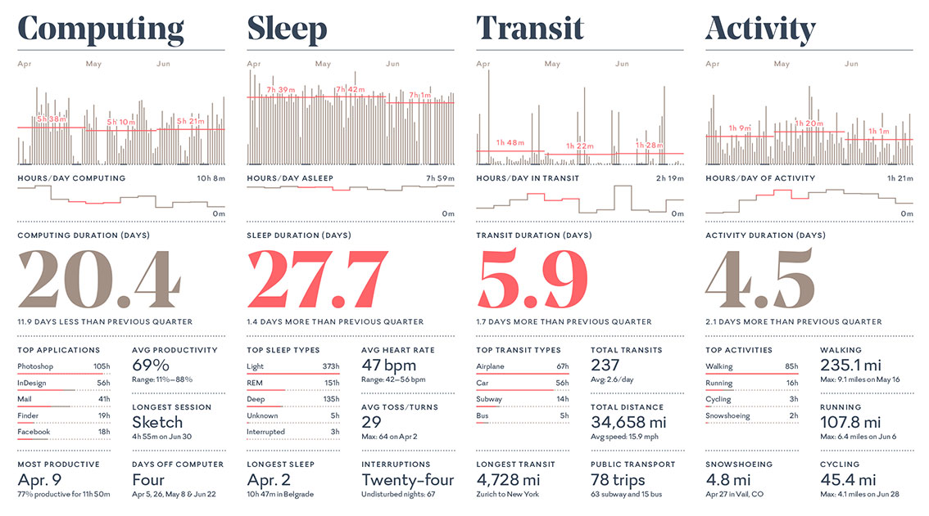
2008 Feltron Report
http://feltron.com
Notes:
Putting this together in a visualization, let’s examine the 2008 Feltron Report. It has a very clear hierarchy, contrast, mixing a serif with a sans serif is a beautiful way.

Slide 53
Word Clouds - Caution
Notes:
Word clouds are not great for visualizing precise quantitative comparisons. They have other issues as well, for example, visualizing unigrams when multi-word phrases would better represent the data. There’s also the issue of understanding context.

Slide 54
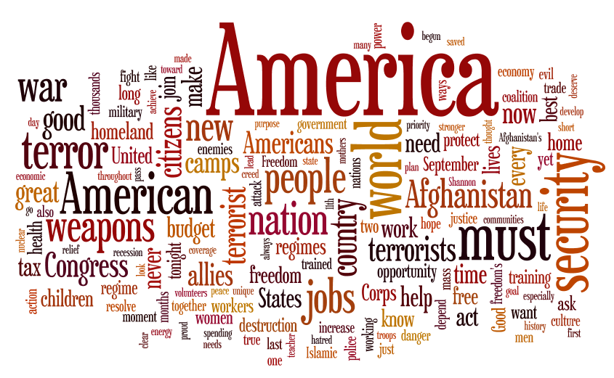
Bush State of the Union - 2002
Notes:
Here is a word cloud of President Bush’s State of the Union from 2002. This was immediately following September 11th. If we know a bit about history then we know what was going on in the world at that time. We see words like “weapons”, “terror”, “terrorist”, “security”, “war” and “Afghanistan”.

Slide 55
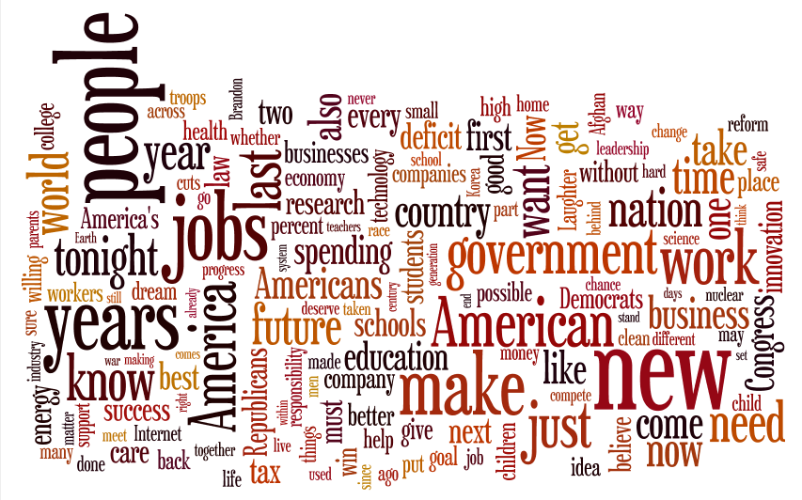
Obama State of the Union - 2010
Notes:
Fast forward to 2010 to President Obama’s State of the Union address, immediately following the financial crisis and when the economy was struggling through the Great Recession. We see words like “jobs”, “government”, “work”. “new”, “future” and “time”.
In both cases we understand what is going on in these word clouds because we understand the context of the world that they are describing. But what happens if we don’t have that context?

Slide 56
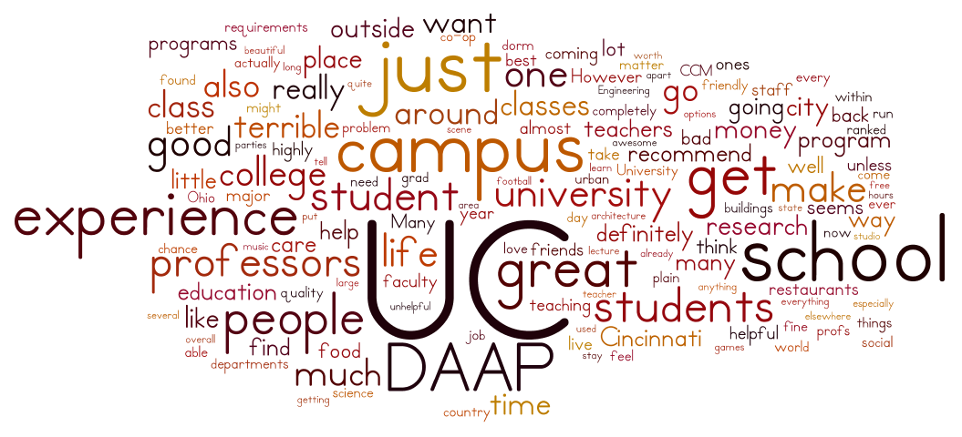
Word cloud on Student Feedback for the University of Cincinnati
Is this good or bad?
Data from: http://www.studentsreview.com/OH/UC_c.html
Notes:
This word cloud was built using data from StudentReviews.com for the University of Cincinnati. So do the students think that UC is good or bad?
[class discussion]
It’s hard to tell. We see “great”, but we also see “terrible” and “good”. Without the context it’s very difficult to understand that this is telling us.

Slide 57
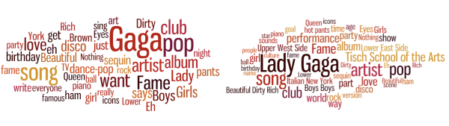
Online Biography of the Pop Singer Lady Gaga
(left) Single-word phrases (unigrams) (right) Multiword phrases
Source: The Stanford Visualization Group (vis.stanford.edu)
"Without the Clutter of Unimportant Words“: Descriptive Keyphrases for Text Visualization
Jason Chuang, Christopher D. Manning, Jeffrey Heer
Notes:
This is an example of the unigram problem. This is from a paper entitled “Without the Clutter of Unimportant Words” published by the Stanford Visualization Group. One the left we see unigrams in the word cloud. Words like “Gaga” and Beautiful” and “York”. Using a different algorithm to find multiword phrases they visualized better contest in the word cloud. For example, her name “Lady Gaga”, places like “New York”, “Upper West Side” and “Tisch School of the Arts”. It also connected words for one of her songs, “Beautiful Dirty Rich”.

Slide 58
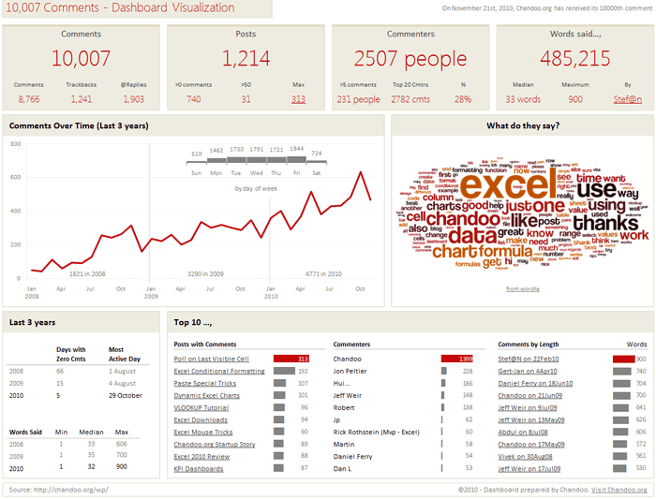
Notes:
This dashboard was created by Chandoo for his Excel blog. If you are doing anything in Excel, then Chandoo and Jon Peltier are two people that you should definitely follow. Chandoo achieved 10,000 comments on his Blog (Chandoo.org) and so he published a visualization. It shows key indicators across the top, Comments, Posts, Commenters and Words said. He has a line chart for the comments over time as well as a histogram showing the days of the week. Along the bottom he has some other statistics, posts with comments, top commenters and comments by length. He included a word cloud using the words in the comments. It’s not surprising that the big words were Excel and his name Chandoo. This dashboard is designed very well, excellent use of color and good chart types for the various comparisons. But consider the space that the word cloud takes up vs. the information that is gained from it.

Slide 59
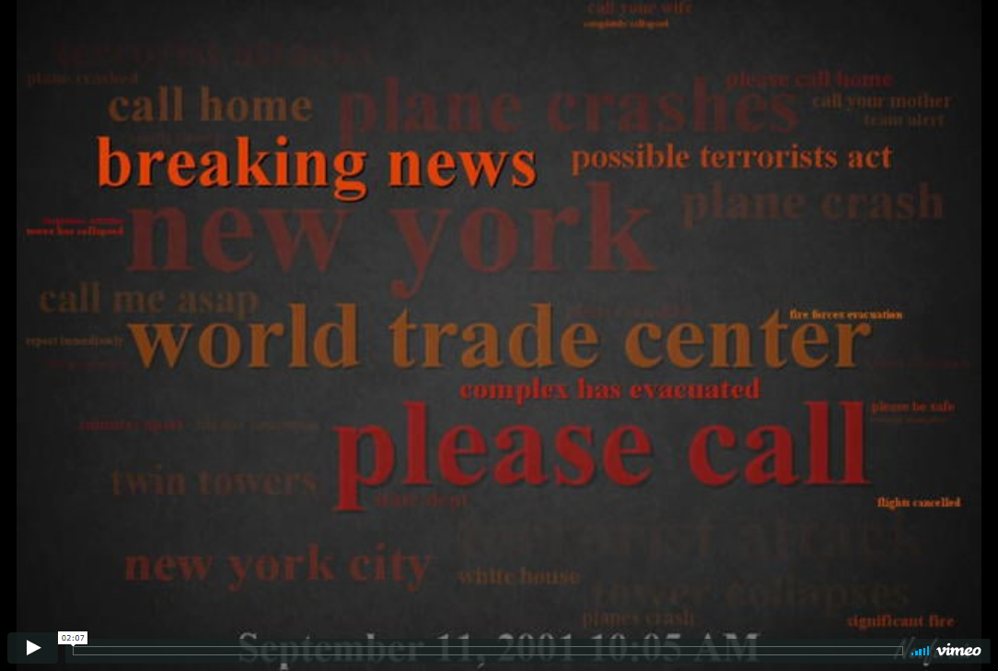
https://vimeo.com/7860125
Notes:
Here is another word cloud, done in a slightly different way. This is the pager data from 911 as published by Wikileaks. You will see a running time on the bottom of the screen in 5 minute increments and the words that are being sent throughout the day. It’s a very powerful visualization.
Created by: Jeff Clark
Source: http://neoformix.com/2009/Sep11PagerData.html

Slide 60


“Perhaps a more useful view of the data is provided by this set of timeline graphs.”
http://neoformix.com/2009/Sep11PagerData.html
Notes:
The author of that video, Jeff Clark, also created this set of charts, noting on his website, “Perhaps a more useful view of the data is provided by this set of timeline graphs.”
[class discussion]
This may be true, but does it have the same impact?
Which view do you prefer and why?
Can you spot trends in the timeline that you didn’t see in the video?

Slide 61

Word Cloud
Let’s Build One
Notes:
NOTE:
We are not advocating for the use of Word Clouds in this section. We hope we’ve outlined the issues with using them.
Hard to make precise quantitative comparisons
Unigrams make it difficult to understand the words in their context
As a text mining tool it is typically hard to gain insight with having a preconceived context of the text.

Slide 62
Building Word Clouds
(a few online tools)
Wordle.net
wordclouds.com tagcrowd.com
Notes:
[Demo – Google search the most recent State of the Union address and copy the transcript (or part of the transcript), then use Wordle.net to create a Word Cloud for the class. You can demonstrate the different fonts, horizontal placement of text, color, style, etc. Wordle.net also has a gallery of the most recent Word Clouds that you can explore.]
[Note – Word Clouds are not built in to the Tableau Show Me, but it is possible to build them in Tableau. This can work better than the websites listed because then it can tie to the visualization and be interactive, for example filtering the visualization by word.]
[http://kb.tableau.com/articles/howto/creating-a-word-cloud]

